Slide 1
CS 33 Discussion 1
April 7,2017

Slide 2
Discussion 1C
TA: Aanchal Dalmia
Email: aanchal204@cs.ucla.edu
Office Hours: Wednesday11:30am-1:30pm
TA Room: BH 2432

Slide 3
Agenda
Overview
How to access SEASNET Linux servers
Representing information as bits
Integers
Representation : signed, unsigned
Conversion, casting
Expanding, truncating
Addition, subtraction, multiplication, shifting
Summary

Slide 4
Overview of Course
http://web.cs.ucla.edu/classes/spring17/cs33/
Grading
40% labs (4, each 10%)
5% homework (5, each 1%)
25% midterms (2, each 12.5%)
30% final exam
Use Piazza for doubts
Discussion slides will be mailed

Slide 5
Course Textbook
The course textbook:
– Computer Systems: A Programmer's Perspective 3rd Edition
– CAUTION: The 2nd Edition, 2nd International Edition and the 3rd Edition all have essentially the same homework questions... except the numbers are different.

Slide 6
Getting Started
Class is based on C
It is highly recommended to work in a Linux environment, specifically the SEASnet Linux Servers
Assignments will be tested on SEASnet Linux servers

Slide 7
Setup
To login to SEASnet you need to be connected to wireless network on campus
OR
Login with VPN Software
https://www.it.ucla.edu/bol/services/virtual-private-network-vpn-clients

Slide 8
Setup Guide for Windows
Download PuTTY
https://the.earth.li/~sgtatham/putty/latest/x86/putty.exe

Slide 9
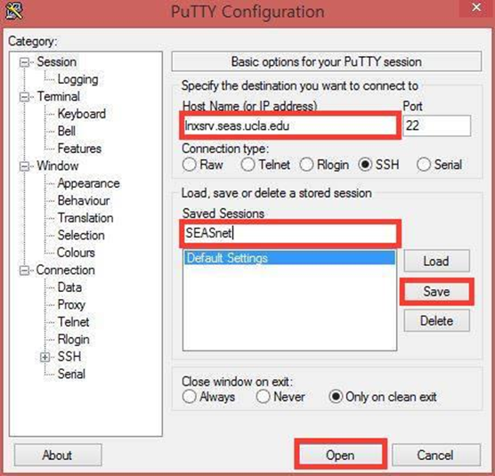
PuTTY
First Run
Type lnxsrv@seas.ucla.edu for Host Name
Type SEASnet for Saved Sessions
Click Save
Click Open
Type your SEASnet username and password
Double-click SEASnet under Saved Sessions in the future

Slide 10
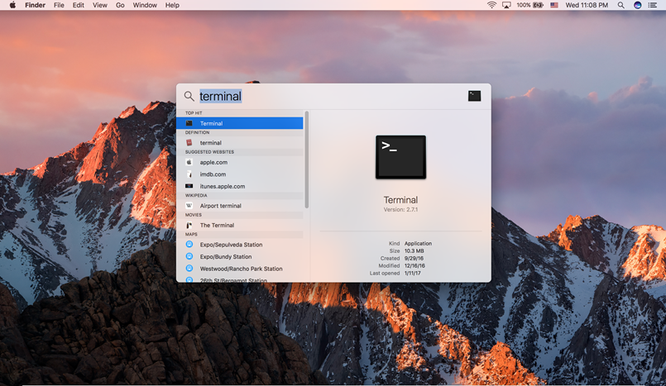
Setup Guide for Mac

Slide 11
Terminal
Type ssh <SEASnet username>@lnxsrv.seas.ucla.edu
Enter your password

Slide 12
Copying from local machine to SEASnet
For Windows users:
– WinSCP: An scp client
– scp stands for secure copy. You use it to secure copy. https://winscp.net/eng/download.php
For Mac and Linux:
– scp is a command that can be issued directly. Open a terminal (for Mac: Applications -> Utilities ->Terminal)

Slide 13
Copying from local machine to SEASnet
For Windows users:
– In “host name”, enter [username]@lnxsrv.seas.ucla.edu
– Right click a file and select upload or download.
For Mac and Linux:
– Local to remote:
scp [file name] [username]@lnxsrv.seas.ucla.edu:.
– Remote to local:
scp [username]@lnxsrv.seas.ucla.edu:<path to file> .

Slide 14
Useful Linux Commands
● Linux command format:
● [command name] -X -Y -Z [argument]
● (X, Y, and Z are optional flags)
● Flags modify/specify the behavior of the command

Slide 15
Useful Linux Commands
● pwd – print working directory
● ls – list contents of current directory
– ls -l (“-l” flag will print contents in long form)
● cd – change directory
– cd a (navigates to the “a” directory which is located in the current directory)
– cd .. (navigate to the parent directory)
– cd ../dir (navigate to a directory called “dir” that is located within the parent)
– cd . (navigate to the current directory. Great work)

Slide 16
Useful Linux Commands
● Editing files. If you're interested familiarizing yourselves with Linux (which will have to happen eventually), it is recommended that you use “vi” or “emacs”.
– vi text.txt
– emacs text.txt
● Commands that start with a colon :
:w save
:x save and quit
:q quit (will trigger error if file hasn't been saved)
:q! quit without saving

Slide 17
Useful Linux Commands
● The standard Linux C compiler is gcc.
– gcc main.c (compile the file main.c into an executable file with default name “a.out”)
– gcc main.c -o main (compile the file main.c into an executable file called “main”)
– gcc main.c -O2 (compile the file with optimizations, level 2)
● Executing executables
– ./main (executes the executable file called “main”)

Slide 18
C (as opposed to C++)
● In a (very simplified) nutshell, C++ is an extension to C.
● The syntax of the language is nearly identical, but you will find that C lacks certain features, namely the “Object Oriented” paradigm.
● Some features are analogous, but have different names.

Slide 19
C (as opposed to C++)
● In C++:
– for(int i = 0; i < size; i++)
● By default, gcc uses a 1990's C standard which prohibits declarations in “for” loops. As a result, you will have to do either
– int i;
– for(i = 0; I < size; i++)
● Or explicitly use gcc to compile with a different C standard
– gcc -std=c99 temp.c

Slide 20
C (as opposed to C++)
Dynamic memory allocation
In C++:
– char * c_arr = new char[10];
– delete c_arr;
– “new” allows you to specify repetitions of a specific data type.

Slide 21
C (as opposed to C++)
● In C, these declarations force you to be more specific. Instead of “new”, use “malloc” and instead of “delete”, use “free”.
– char * c_arr = (char *) malloc(sizeof(char) * 10);
– free(c_arr);
● Note: These are analogous but not the same.
● “malloc” and other “_alloc” variations operate on the principle that you're specifying a specific amount of memory to allocate rather than a specific data type.

Slide 22
C (as opposed to C++)
Instead of:
– int x = 10;
– cout << x;
You'll use “printf”
– printf(“hello”);
– printf(“%d”, x);
printf takes in as the first parameter a string to print out that is populated with format codes that correspond to the remaining arguments.

Slide 23
Fwrapv, ftrapv Flags
fwrapv - instructs the compiler to assume that signed arithmetic overflow of addition, subtraction and multiplication wraps around using twos-complement representation.
ftrapv - generates traps for signed overflow on addition, subtraction, multiplication operations.

Slide 24
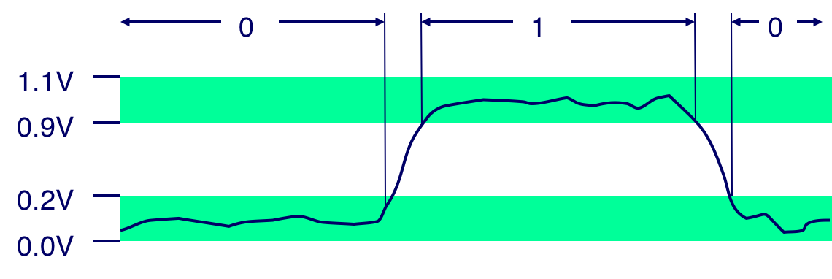
Everything is bits
Each bit is 0 or 1
By encoding/interpreting sets of bits in various ways
Computers determine what to do (instructions)
… and represent and manipulate numbers, sets, strings, etc…
Why bits? Electronic Implementation
Easy to store with bistable elements
Reliably transmitted on noisy and inaccurate wires

Slide 25
For example, can count in binary
Base 2 Number Representation
Represent 15213₁₀ as 11101101101101₂
Represent 1.20₁₀ as 1.0011001100110011[0011]……...₂
Represent 1.5213 X 10⁴ as 1.1101101101101₂ X 2¹³

Slide 26
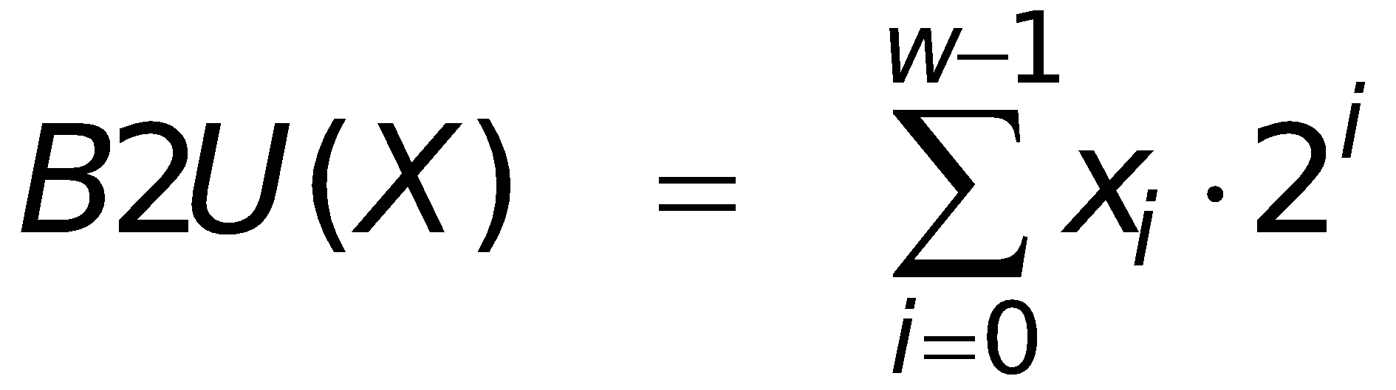
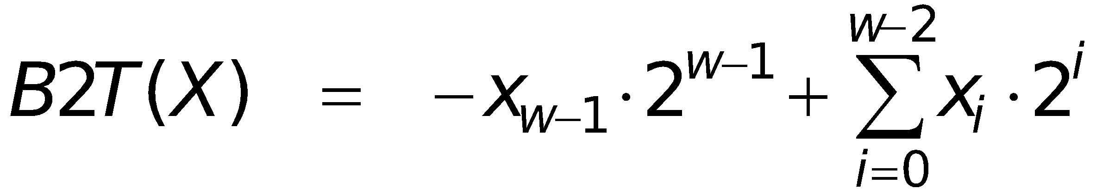
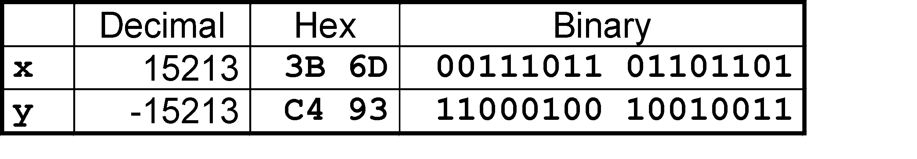
Encoding Integers
Unsigned
Two’s Complement
short int x = 15213;
short int y = -15213;
Sign
Bit
C short 2 bytes long
Sign Bit
For 2’s complement, most significant bit indicates sign
0 for nonnegative
1 for negative

Slide 27
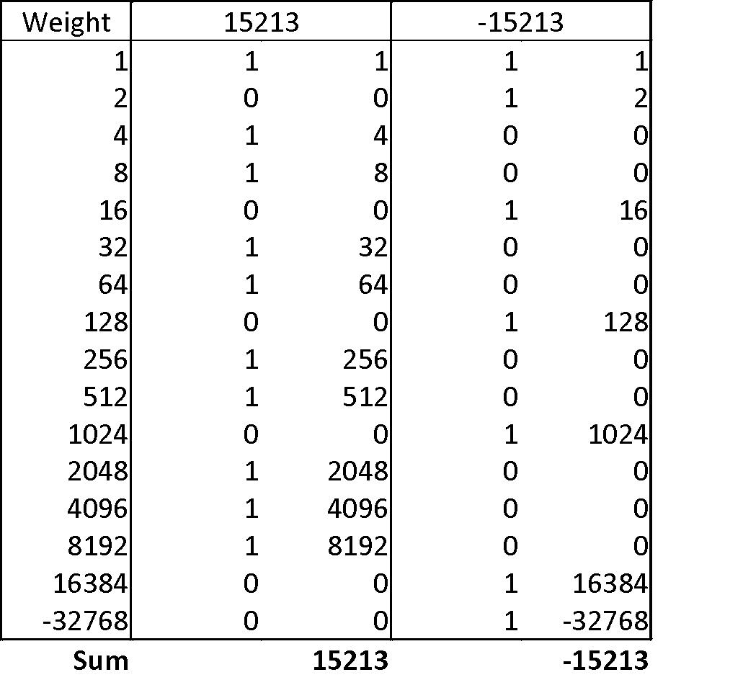
Two-complement Encoding Example (Cont.)
x = 15213: 00111011 01101101
y = -15213: 11000100 10010011

Slide 28
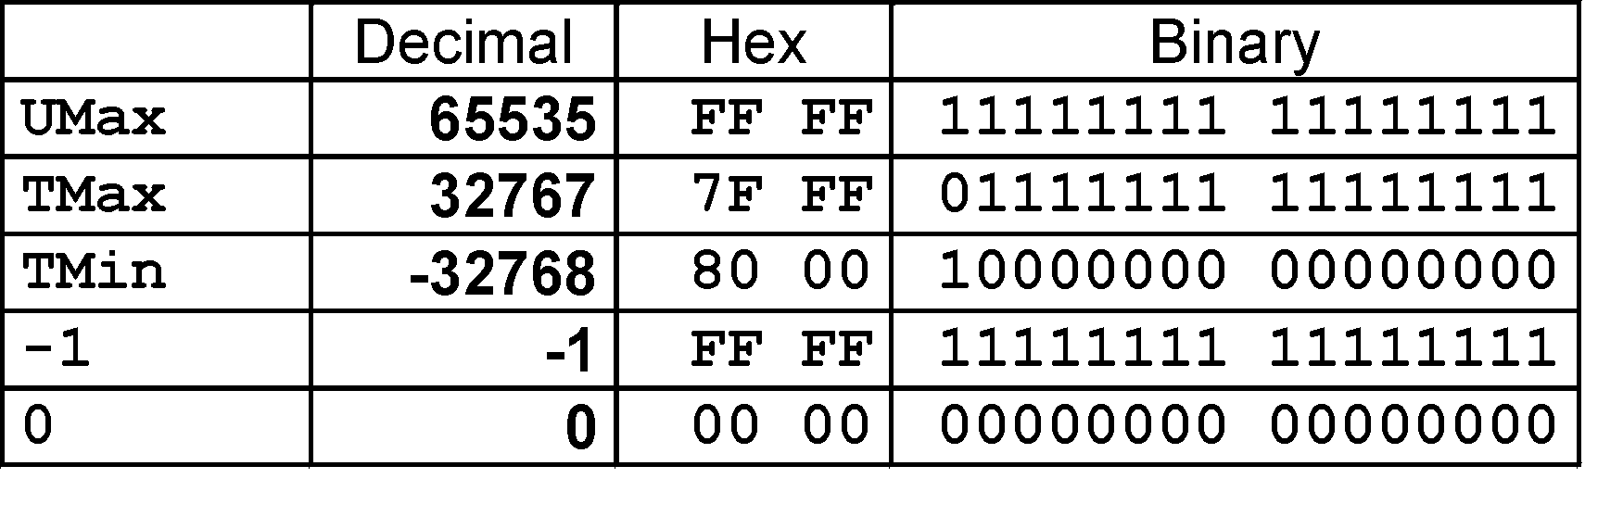
Numeric Ranges
Unsigned Values
UMin = 0
000…0
UMax = 2^{w} – 1
111…1
Two’s Complement Values
TMin = –2^{w–1}
100…0
TMax = 2^{w–1} – 1
011…1
Other Values
Minus 1
111…1
Values for W = 16

Slide 29
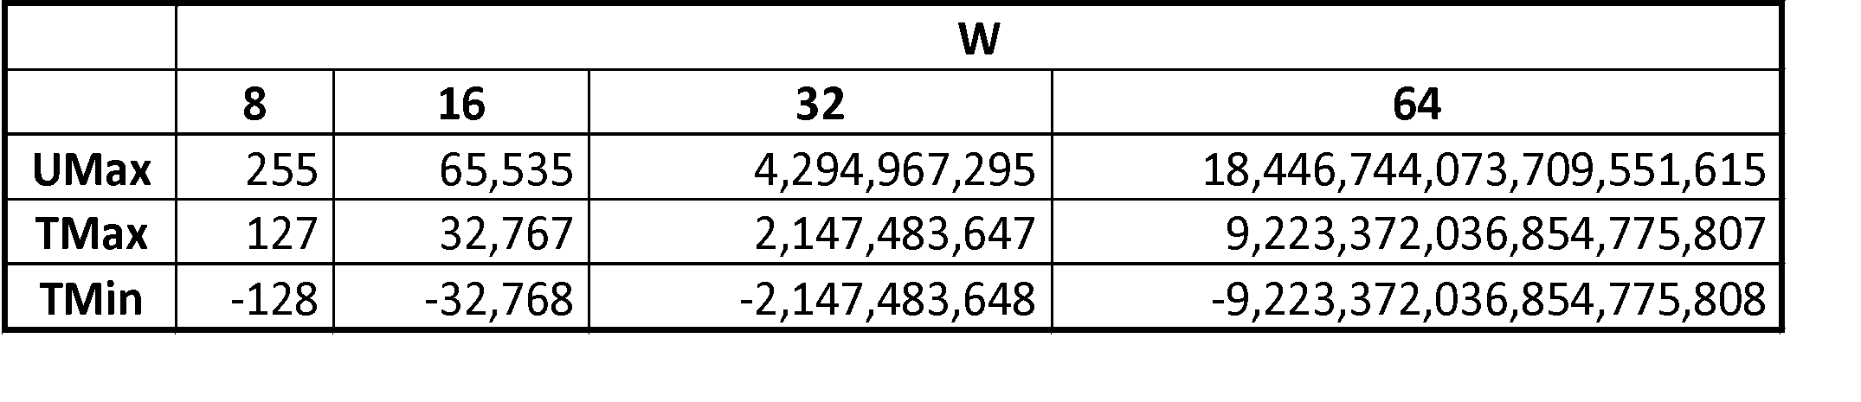
Values for Different Word Sizes
Observations
|TMin | = TMax + 1
Asymmetric range
UMax = 2 * TMax + 1
C Programming
#include <limits.h>
Declares constants, e.g.,
ULONG_MAX
LONG_MAX
LONG_MIN
Values platform specific

Slide 30
Unsigned & Signed Numeric Values
Equivalence
Same encodings for nonnegative values
Uniqueness
Every bit pattern represents unique integer value
Each representable integer has unique bit encoding
⇒ Can Invert Mappings
U2B(x) = B2U⁻¹(x)
Bit pattern for unsigned integer
T2B(x) = B2T⁻¹(x)
Bit pattern for two’s comp integer
X
B2U(X)
B2T(X)
0000
0
0
0001
1
1
0010
2
2
0011
3
3
0100
4
4
0101
5
5
0110
6
6
0111
7
7
1000
8
–8
1001
9
–7
1010
10
–6
1011
11
–5
1100
12
–4
1101
13
–3
1110
14
–2
1111
15
–1

Slide 31
Mapping Between Signed & Unsigned
Two’s Complement
Unsigned
T2U
x
T2B
B2U
ux
X
Maintain Same Bit Pattern
Unsigned
U2T
Two’s Complement
ux
U2B
B2T
x
X
Maintain Same Bit Pattern
Mappings between unsigned and two’s complement numbers: Keep bit representations and reinterpret

Slide 32
Mapping Signed ↔ Unsigned
Bits
0000
0001
0010
0011
0100
0101
0110
0111
1000
1001
1010
1011
1100
1101
1110
1111
Signed
0
1
2
3
4
5
6
7
-8
-7
-6
-5
-4
-3
-2
-1
Unsigned
0
1
2
3
4
5
6
7
8
9
10
11
12
13
14
15
T2U
U2T

Slide 33
Mapping Signed ↔ Unsigned
Bits
0000
0001
0010
0011
0100
0101
0110
0111
1000
1001
1010
1011
1100
1101
1110
1111
Signed
0
1
2
3
4
5
6
7
-8
-7
-6
-5
-4
-3
-2
-1
Unsigned
0
1
2
3
4
5
6
7
8
9
10
11
12
13
14
15
=
+/- 16

Slide 34
Relation between Signed & Unsigned
Two’s Complement
Unsigned
T2U
x
T2B
B2U
ux
X
Maintain Same Bit Pattern
w–1
0
ux
+
+
+
• • •
+
+
+
x
-
+
+
• • •
+
+
+
Large negative weight
becomes
Large positive weight

Slide 35
Conversion Visualized
2’s Comp. → Unsigned
Ordering Inversion
Negative → Big Positive
UMax
UMax – 1
TMax + 1
Unsigned
Range
TMax
TMax
2’s Complement Range
0
0
–1
–2
TMin

Slide 36
Signed vs. Unsigned in C
Constants
By default are considered to be signed integers
Unsigned if have “U” as suffix
0U, 4294967259U
Casting
Explicit casting between signed & unsigned same as U2T and T2U
int tx, ty;
unsigned ux, uy;
tx = (int) ux;
uy = (unsigned) ty;
Implicit casting also occurs via assignments and procedure calls
tx = ux;
uy = ty;

Slide 37
Casting Surprises
Expression Evaluation
If there is a mix of unsigned and signed in single expression, signed values implicitly cast to unsigned
Including comparison operations <, >, ==, <=, >=
Examples for W = 32: TMIN = -2,147,483,648 , TMAX = 2,147,483,647

Slide 38
Casting Surprises
Constant₁ | Constant₂ | Relation | Evaluation
0 | 0U | == | unsigned
-1 | 0 | < | signed
-1 | 0U | > | unsigned
2147483647 | -2147483647-1 | > | signed
2147483647U | 2147483647U | < | unsigned
-1 | -2 | > | signed
(unsigned)-1 | -2 | > | unsigned
2147483647 | 2147483648U | < | unsigned
2147483647 | (int) 2147483648U | > | signed

Slide 39
Sign Extension
Task:
Given w-bit signed integer x
Convert it to w+k-bit integer with same value
Rule:
Make k copies of sign bit:
X ′ = x_{w–1} ,…, x_{w–1} , x_{w–1} , x_{w–2} ,…, x₀
w
k copies of MSB
X
• • •
• • •
X ′
• • •
• • •
k
w

Slide 40
Sign Extension Example
short int x = 15213;
int ix = (int) x;
short int y = -15213;
int iy = (int) y;
Decimal
Hex
Binary
x
15213
3B 6D
00111011 01101101
ix
15213
00 00 3B 6D
00000000 00000000 00111011 01101101
y
-15213
C4 93
11000100 10010011
iy
-15213
FF FF C4 93
11111111 11111111 11000100 10010011
Converting from smaller to larger integer data type
C automatically performs sign extension

Slide 41
Summary: Expanding, Truncating: Basic Rules
Expanding (e.g., short int to int)
Unsigned: zeros added
Signed: sign extension
Both yield expected result
Truncating (e.g., unsigned to unsigned short)
Unsigned/signed: bits are truncated
Result reinterpreted
Unsigned: mod operation
Signed: similar to mod
For small numbers yields expected behavior

Slide 42
Signed Binary: Two's Complement
How do we represent negative numbers?
The two's complement of a number is technically it's value subtracted from 2N.
In two's complement, most bits have the same contribution as in unsigned. The value of the i-th bit is 2^i (assuming i starts from 0).
However, the most significant bit of an N bit number has a value of -2^N-1 instead of 2^N-1

Slide 43
Signed Binary: Two's Complement
● Assume we're dealing with four bit numbers.
● Consider the unsigned binary number 1010:
– 1010 = 1*2^3 + 0*2^2 + 1*2^1 + 0*2^0 = 10
● Now consider the signed binary number 1010:
– 1010 = 1*(-(2^3)) + 0*2^2 + 1*2^1 + 0*2^0 = -6

Slide 44
How to convert between negative and positive
● The method: take the bitwise inverse and add one.
Consider 0101 (5).
1. 0101
2. Bitwise inverse of 0101 = 1010.
3. 1010 + 0001 = 1011.
4. Confirm: 1011 = (-(2^3)) + 2^1 + 2^0 = -5

Slide 45
Signed Binary: Notes
● The value of a signed binary number depends on the number of bits there are.
– Four bit signed: 1111 = -1
– Five bit signed: 01111 = 15
● An N-bit signed binary number has 2^N possible values with a range of [-2^N-1, 2^N-1-1].
● REMEMBER THIS: The range of a twos complement signed binary number is not
symmetrical around 0.
● Henceforth all signed binary is two's complement unless otherwise specified.

Slide 46
Binary arithmetic
● What does it mean to add bits?
● The idea is the same as in decimal. Let's try with unsigned.
0001 0001 0001 0011
+ 0010 + 0001 + 0111 + 0111
---------- -------- ---------- --------
0011 0010 1000 1010
Note that adding two or three 1 bits will produce a carry bit that must be added to the next bit over.

Slide 47
Binary arithmetic
● How about subtraction? You can generalize the
decimal method for binary, but...
● The simplest way to do X – Y is to do X + (-Y).
● Take 0110 (6) – 0010 (2)
● This becomes 0110 (6) + 1110 (-2)
0110
+ 1110
----------
0100

Slide 48
Unsigned overflow in C
● With signed arithmetic, we saw that a carry out bit was
completely valid, but what about unsigned?
● Say we have 4-bit numbers and we add 6 + 12.
● 6 = 0110, 12 = 1100
0110
+ 1100
--------
10010 = 18
● ...but this requires 5 bits to represent. We only have 4.

Slide 49
Unsigned overflow in C
● Just drop bits.
● If an unsigned operation of an n-bit number requires more than n bits, the resulting number will consist only of the n least significant bits.
– Ex. In the previous example:
– 0110 + 1100 = (1) 0010, the leading one is dropped and instead of the right answer of 18, you get the incredibly wrong answer of 2
● More formally, if you have n-bits, the computation of x + y is (x + y) % 2^{n}.
– Ex. (6 + 12) % 24 = 18 % 16 = 2

Slide 50
Unsigned overflow in C
● This is also true of unsigned multiplication overflow:
● If we have 4 bits, 6 * 12 = 72
● In binary, 72 is 1001000.
● Truncate bits beyond 4 and the result is 1000 = 8.
● 72 % 24 = 8
● Keep in mind, this is for unsigned numbers only.
● Let's not think about signed numbers for now.

Slide 51
Datatypes in C
● Each native datatype in C is expressed by a sequence of bits.
● Simple data types such as ints and shorts come in unsigned and signed variants where signed is the default (ie. int is actually a signed int)
● However, the number of bits used to express these numbers differs depending on whether the processor is 32 or 64-bit.
● ...but more on the processor definitions later.

Slide 52
Datatypes in C
● char/unsigned char : 8-bits
● short/unsigned short : 16-bits
● int/unsigned (int) : 32-bits
Here's where it gets weird.
● In 32-bit machines:
– long/unsigned long : 32-bits
– long long/unsigned long long (further proof that a five year
old named these) : 64-bits
● In 64-bit machines:
– long/unsigned long : 64-bits
– long long/unsigned long long (ugh) : 64-bits

Slide 53
Boolean Operators
● Boolean operators operate on a single bit.
● AND : &
– Result is 1 if both inputs are 1.
● OR : |
– Result is 1 if either of the inputs are 1.
● XOR : ^
– Result is 1 if one input is 1 and the other is 0
● NOT : ~
– Result is 1 if the input is 0.

Slide 54
Bitwise Operators
● Bitwise operators perform repeated boolean operations on each bit of a number or pair of numbers.
● Bitwise invert (not the same as logical invert or '!')
– ~(1011) = 0100
● Bitwise AND/OR (not the same as logical AND/OR or &&/||)
– 1010 & 1100 = 1000
– 1010 | 1100 = 1110
● Bitwise XOR
– 1010 & 1100 = 0110

Slide 55
Bitwise Operators
● Left shift/right shift (arithmetic vs logical)
● Left shift
– 0111 << 1 = 1110
● Right shift
– 1011 >> 1 = 0101 (logical)
– 1011 >> 1 = 1101 (arithmetic)
● Why two different right shifts?

Slide 56
Logical Operators
● Where bitwise operators operate on each individual bit of a number, logical operators operate on the number as a whole
– II, &&, !
● To invert a bit sequence x, you would use ~x.
What happens if you use the logical invert '!'?
● !(1010) = 0
● !(0111) = 0
● !(0) = 1

Slide 57
Logical Operators
● What happens when you use logical operators on numbers?
1011 && 1100?
● Non-zero numbers are interpreted as 1 and 0 is interpreted as... 0.
1011 && 1100 <=> 1
1011 && 0 <=> 0
1011 || 0 <=> 1

Slide 58
Useful Tips

Slide 59
x is a bit vector
if(x == 0)
return 0;
else
return 1;
OR
return !!x;

Slide 60
a, b, and c are bits
if(a)
return b;
else
return c;
OR
return (a & b) | (~a & c)

Slide 61
De-Morgan’s Law
a & b = ~(~a | ~b)
a | b = ~(~a & ~b)

Slide 62
Multiplication by Shifting
● Consider the 4-bit unsigned number 0110.
– 0110 = 2^3 * 0 + 2^2 * 1 + 2^1 * 1 + 2^0 * 0 = 2^2 + 2^1 = 6
● 0110 << 1 = 1100
– 1100 = 2^3 * 1 + 2^2 * 1 + 2^1 * 0 + 2^0 * 0 = 2^3 + 2^2
– 2^3 + 2^2 = 2*(2^2 + 2^1) = 12
● x << n = x * 2^n

Slide 63
Multiplication by Shifting
How can we think of multiplying two arbitrary (ie non-powers of two) numbers in binary?
0110 * 1011 (= 6 * 11 = 66)
= 0110 * (1000 + 0010 + 0001)
= 0110 * 1000 + 0110 * 0010 + 0110 * 0001
= 0110 << 3 + 0110 << 1 + 0110
= 0110000 + 01100 + 0110
= 1000010

Slide 64
Division by shifting
By the same logic, this ought to work for division right?
Consider 4-bit unsigned:
– 1100 = 12
– 1100 >> 1 = 0110 = 6
Consider 4-bit signed:
– 1100 = -4
– 1100 >> 1 = 0110 = 6 (??)

Slide 65
Division by shifting
● Previously, we tried logical right shifting (shift in zeros, but that didn't seem to pan out). This is where arithmetic right shifting steps in.
● Consider 4-bit signed:
– 1100 = -4
– 1100 >> 1 = 1110 = -2
● Logical shifting maintains correct values for unsigned operations while arithmetic shifting maintains correct values for signed operations.

Slide 66
Access specific bits
Say you have the binary value 1010 and you only want to consider bits 1 and 2, that is, you want to transform 1010 into 0010.
1010
& 0110
------------
0010

Slide 67
References
Slides modified from DJ Kim, UT Wang, Shikhar Malhotra and
http://www.cs.cmu.edu/afs/cs/academic/class/15213-f15/www/schedule.html

Slide 68
Thank You

